Slide 1


Network Sniffer
A Cross-Platform Solution for Real-Time Packet Analysis

Slide 2
Table of contents
01
02
03
04
05
06
Fundamentals
Architecture
User Interface
Code Snippets
Novel Features
Competitive Analysis
Conclusion

Slide 3
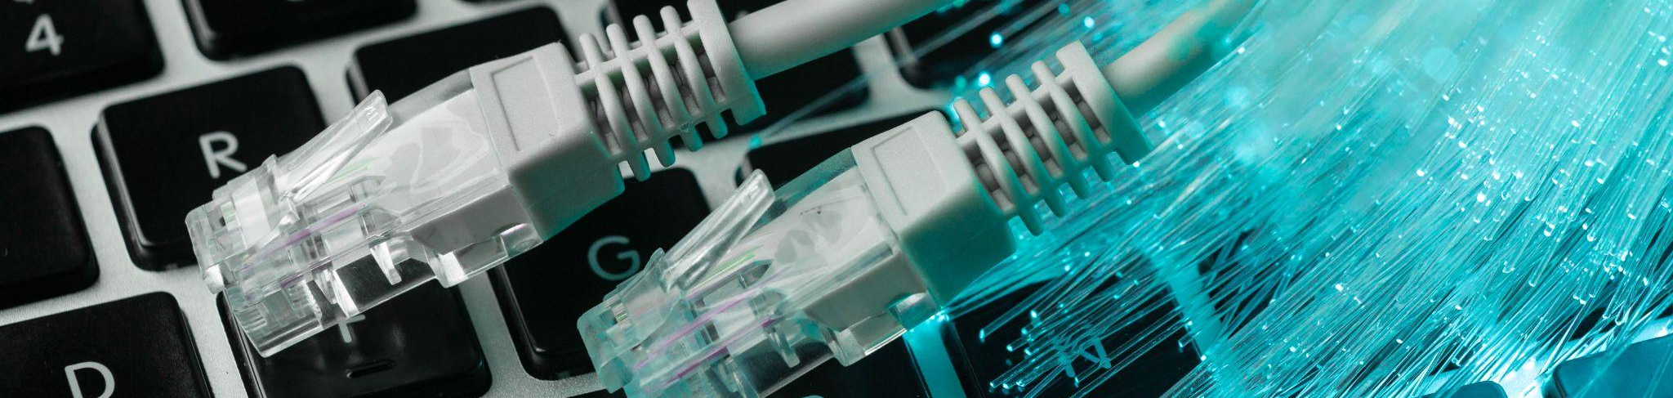
01
Fundamentals

Slide 4
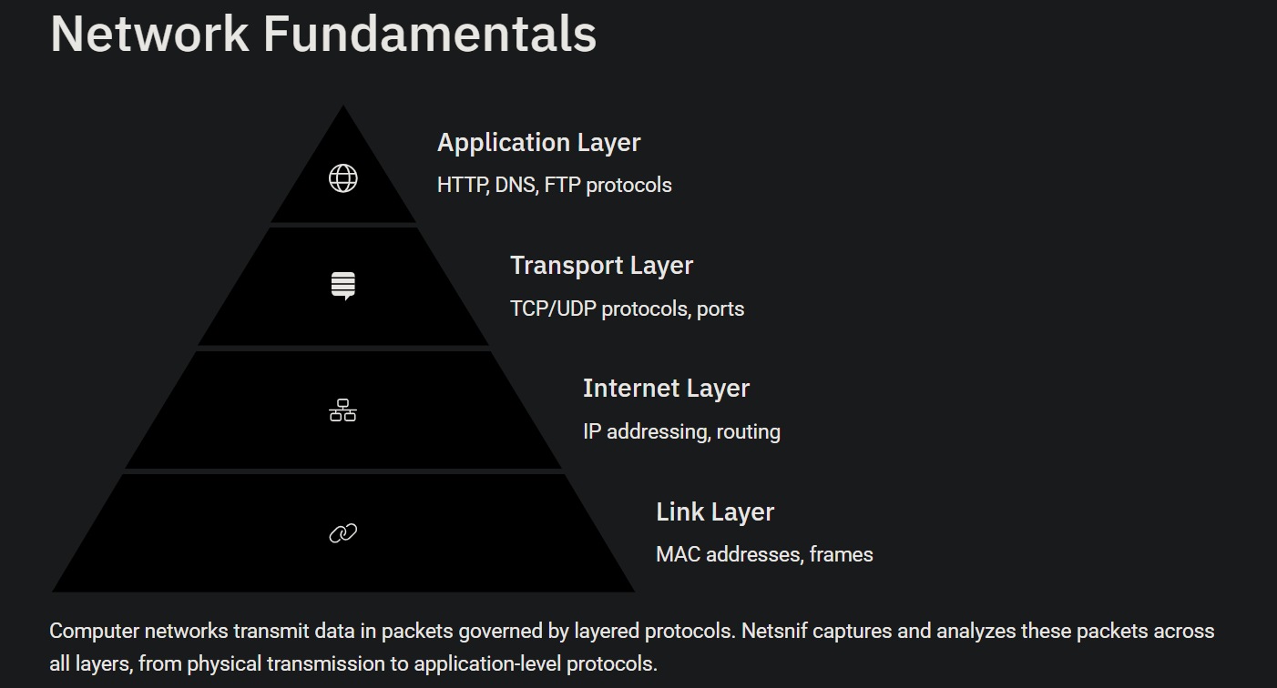

Slide 5
02
Architecture

Slide 6
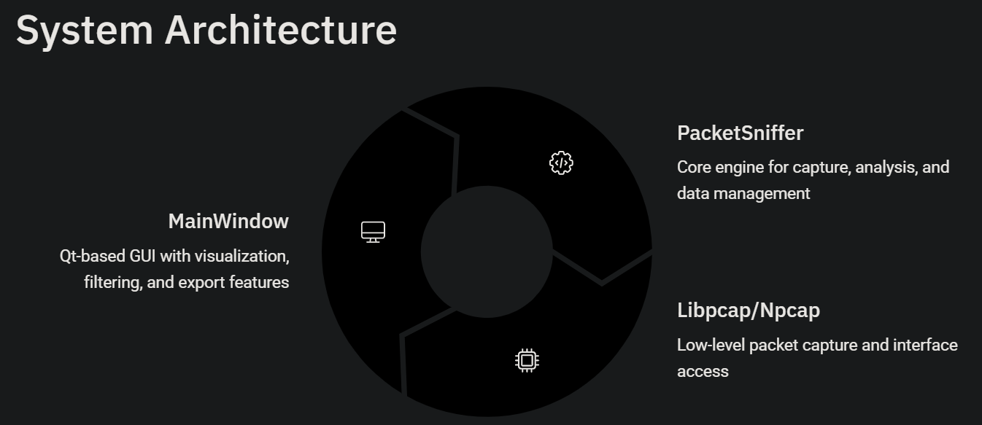

Slide 7
03
User Interface

Slide 8
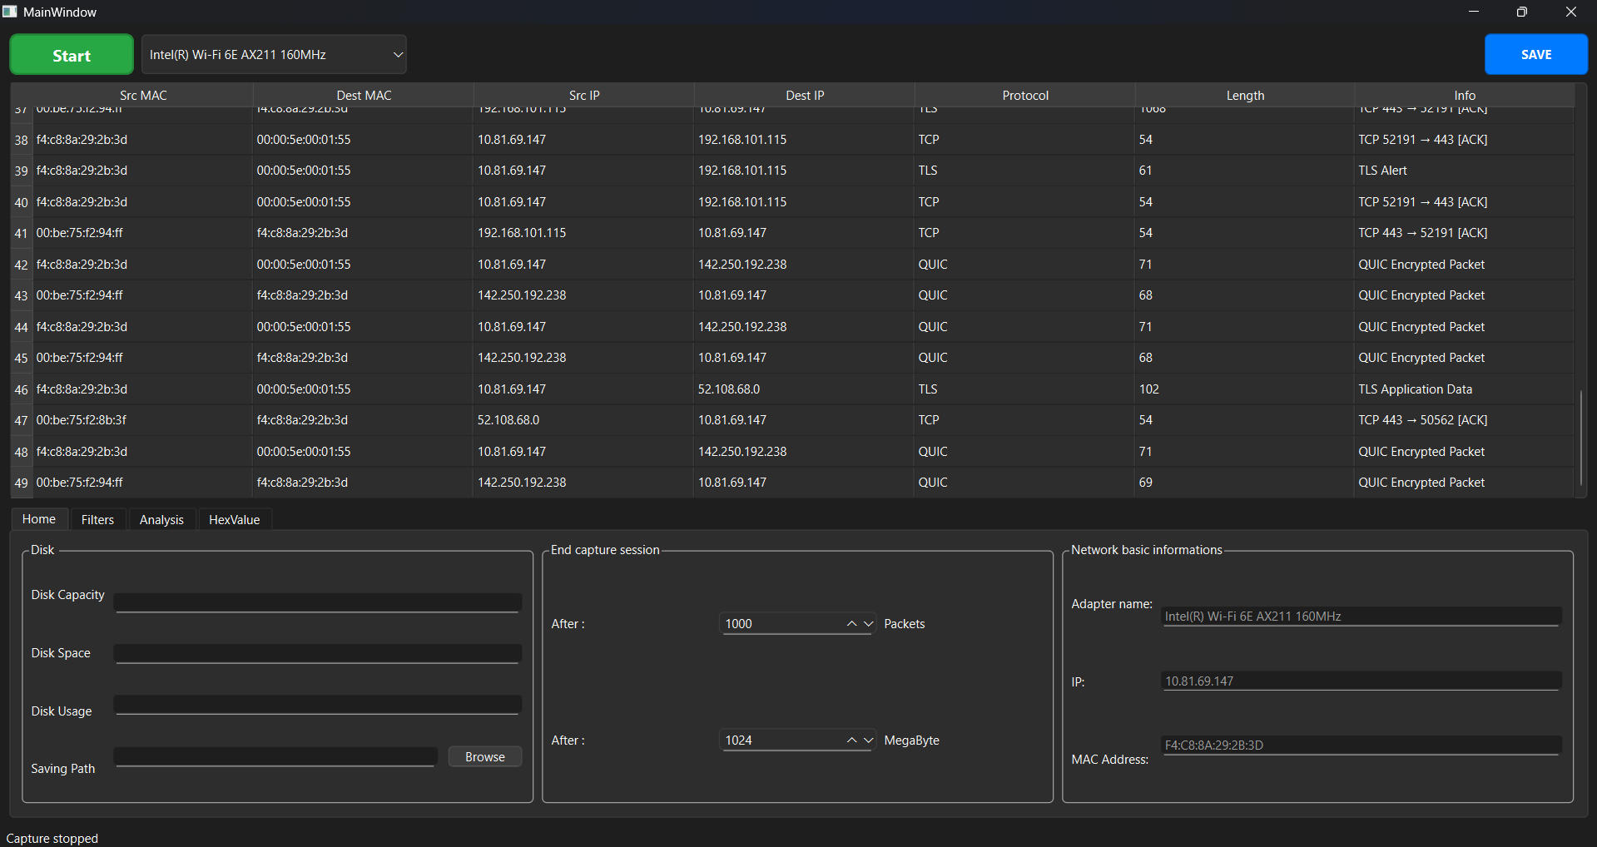
User Interface

Slide 9
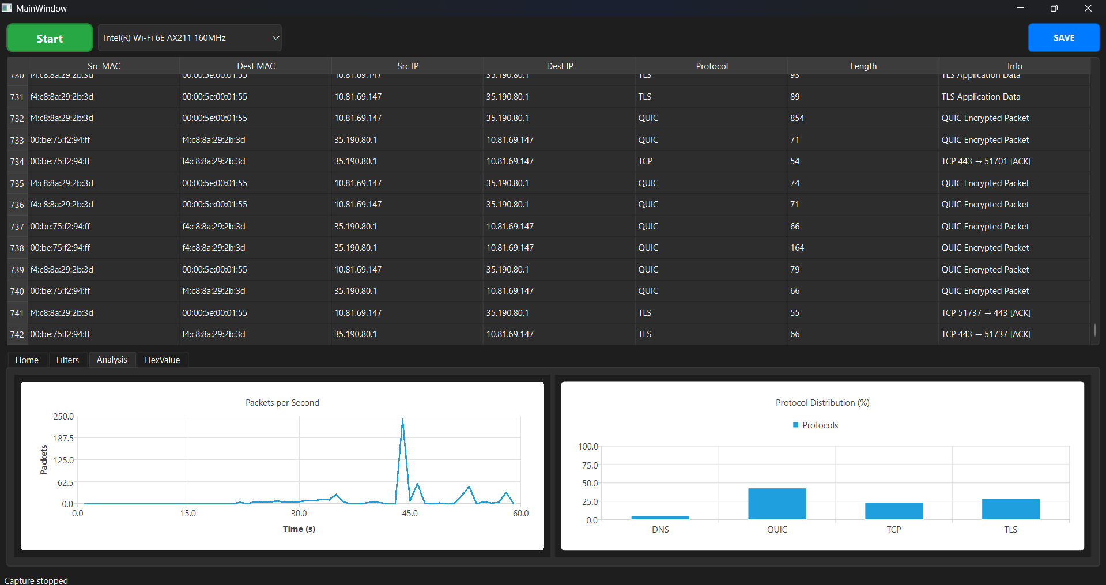
User Interface

Slide 10
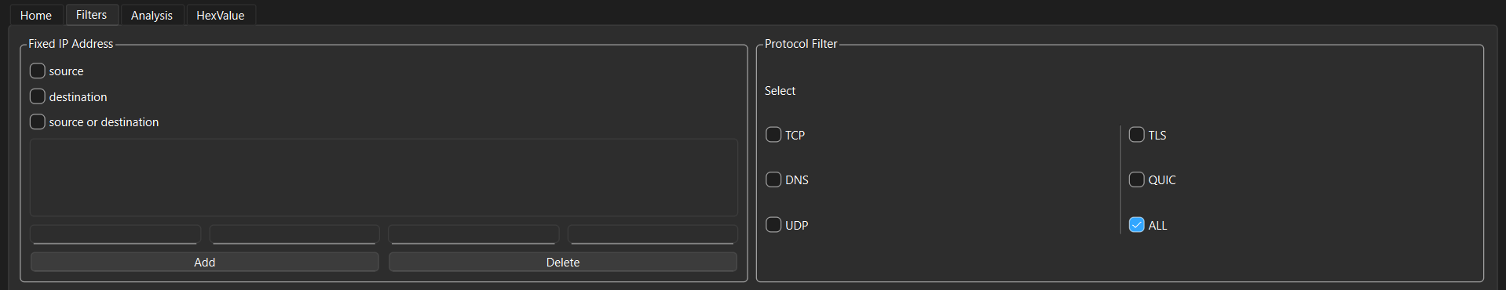
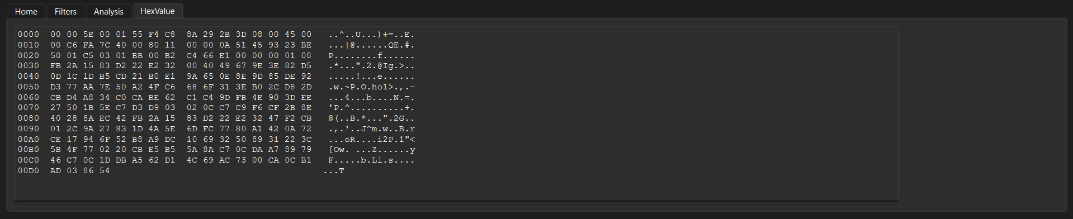
User Interface

Slide 11

Code Snippet
04

Slide 12
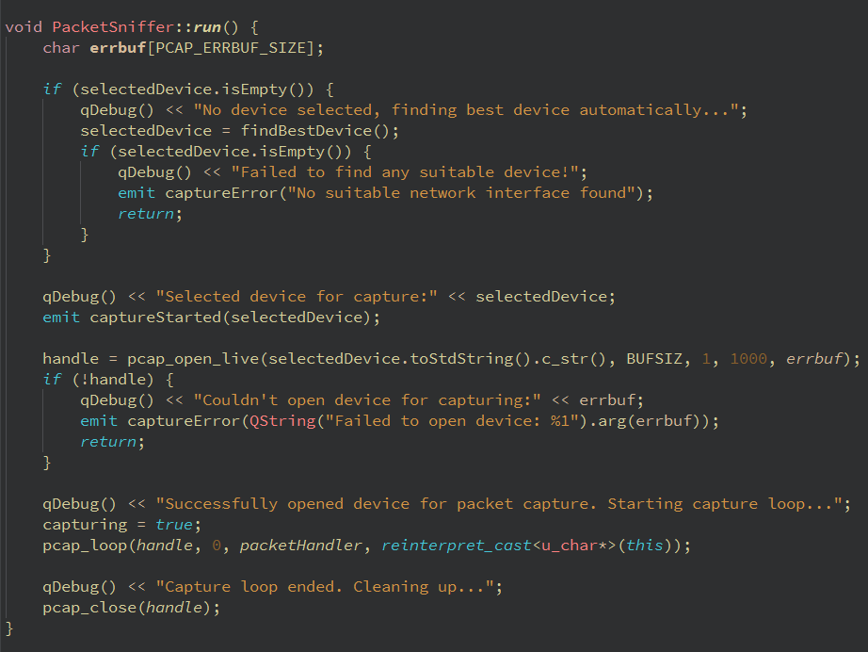
Code Snippet
PacketSniffer::run
Uses pcap_open_live to begin live packet capture with a timeout.
Starts the capture loop using pcap_loop, binding the handler function.
Displays debug logs and error messages for better traceability.

Slide 13
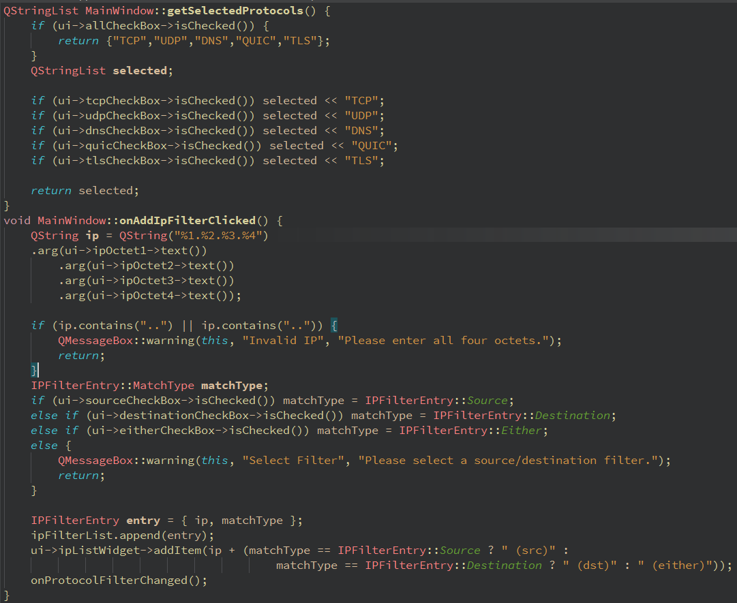
Code Snippet
getSelectedProtocols
onAddIpFilterClicked
Allows users to add IP filters based on source, destination, or either.
Ensures valid IP input by checking for all four octets.
Users can select specific protocols like TCP, UDP, DNS, etc.
Filters help refine which packets are displayed or logged.

Slide 14
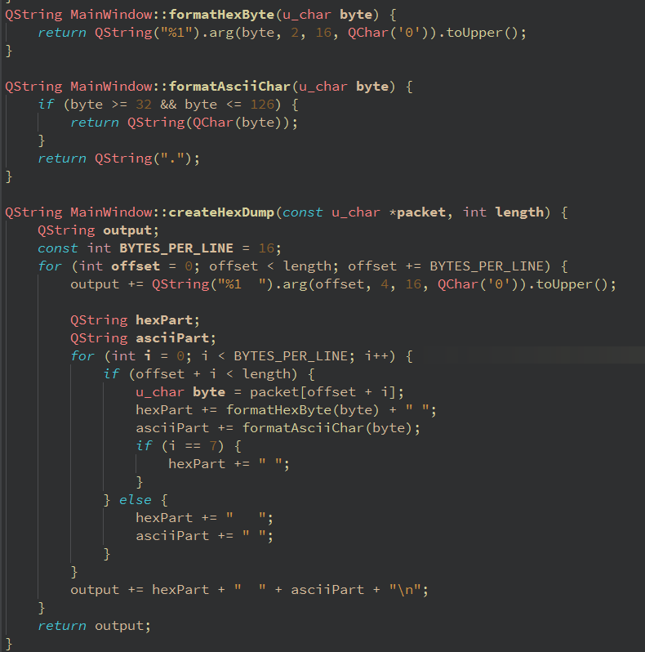
Code Snippet
formatHexByte
formatAsciiChar
createHexDump
Converts each byte of packet data into a readable hex and ASCII format.
Helps visualize raw packet content in a structured way.
Adds spacing and alignment to mimic classic hex dump tools.

Slide 15
05
Novel Features Competitive Analysis

Slide 16



Novel Features
Visualization
Data Management
Real-time analysis
Live packet capture and display
Protocol and IP-based filtering
Instant statistics updates
Protocol distribution charts
Traffic volume graphs
Detailed hex dump viewer
CSV and PCAP exports
Customizable capture constraints
Smart device selection

Slide 17
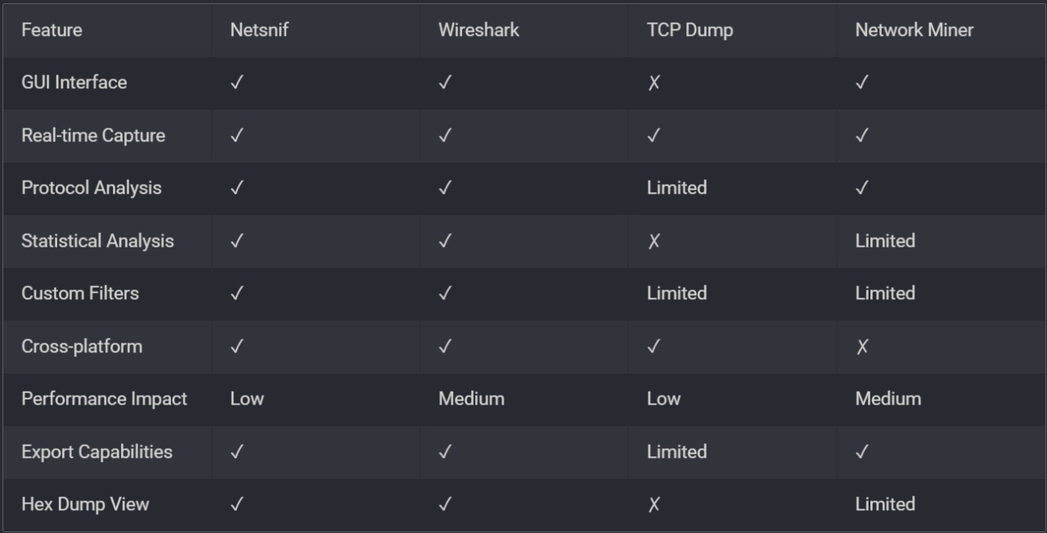
Comparative Analysis

Slide 18
Conclusion
06

Slide 19
Conclusion
Netsnif delivers a powerful yet user-friendly platform for real-time network packet analysis. With advanced filtering, protocol decoding, and visual statistics, it stands as a practical tool for both professionals and students.
The project exemplifies strong modular design and reliable cross-platform support. Its architecture ensures maintainability, scalability, and efficient performance.
Future enhancements include adding support for encrypted traffic analysis and integrating automated threat detection mechanisms. These upgrades will enhance Netsnif’s capabilities in both security research and real-time network monitoring.

Slide 20
Contributions
Harshit and Utkarsh
Implemented the PacketSniffer engine for real-time packet capture using Npcap. Developed filtering logic for protocols and IP and performed thorough testing to ensure stability and correctness.
Aastik and Pradyumn
Built CSV and PCAP export features and implemented live protocol distribution and traffic graphs using Qt Charts. Developed the hex dump viewer to visualize raw packet data in both hex and ASCII formats.
Suprajeet and Ridham
Designed the application interface using Qt Designer and styled it with custom stylesheets. Integrated all UI components (device selection, filters, charts, hex view) with backend logic using Qt signals and slots.

Slide 21
Team Members
Aastik Bansal 23114002
Harshit Kumar Meena 23114037
Utkarsh Raj 23114102
Pradyumn Kejriwal 23114081
Ridham Dave 23114087
Suprajeet Suman 23114097

Slide 22
Project Timeline
Project Proposal and Planning
25-02-2025 to 01-03-2025
Software Requirements and Specification analysis
21-03-2025 to 28-03-2025
Packet Capturing and decoding
04-04-2025 to 11-04-2025
Feasibility Study
14-03-2025 to 20-03-2025
Design and Implementation
28-03-2025 to 04-04-2025
Final Testing and Deployment
12-04-2025 to 24-04-2025

Slide 23
THANK YOU

